Slide 1


GOVERNMENT OF KARNATAKA
DEPARTMENT OF TECHNICAL EDUCATION
GOVERNMENT ENGINEERING COLLEGE, TALAKAL-583238
DEPARTMENT OF COMPUTER SCIENCE & ENGINEERING
MAJOR PROJECT PHASE-1
ON
“SMART STREET LIGHT SYSTEM”
Presented by:
BINDU HALLI (2LG22CS008)
MEGHANA (2LG22CS020)
SAHANA DAVANAGERI (2LG22CS035)
SINCHANA H (2LG22CS046)
Under the guidance of:
Prof. SWATI RUDRAPPA CHAVADI

Slide 2
CONTENTS
Abstract
Introduction
Literature Survey
System Model
Requirement Specification
System Design and Analysis
System Implementation
Results
Conclusion
References

Slide 3
ABSTRACT
In 3D medical imaging, anatomical and other structures such as kidney stones are often identified and extracted with the aid of diagnosis and assessment of disease.
In this investigation, a deep analysis of stone detection in kidneys with image processing techniques using CT images was examined.
This is one of the important issues over the world to detect the proper location of stone throughout the kidney.
This is a very effective way to properly detect the stone.
This is used to examine the kidney region and identify the kidney stone.

Slide 4
INTRODUCTION
The production of crystals in the urine induced by genetic predisposition distinguishes renal calculus also known as kidney stone formation.
The presence of stones in the kidney reduces renal functionality and can potentially cause dilation.
Due to its asymptomatic character, it is frequently detected during medical examinations for other diseases such as cardiovascular disease (CVD), diabetes and other medical problems that predispose to the urogenital apparatus.
The main objective of this project is to detect the kidney stone from a digital ultrasound image of the kidney by performing various image processing techniques.
The main motive of this project was to develop an elementary and straightforward technique to find the stone in the kidney.

Slide 5
LITERATURE SURVEY
In order to eliminate or reduce inaccurate detection of kidney stones many of the researchers have given their contribution by providing efficient kidney stone detection algorithms.
Malala et al. [6] investigated a c-arm tomographic technique to develop three dimensional structure of Kidney.
Kidney stone detection is done in an improved method by using Doppler imaging sequence by Cunitz et al.
Marsousi et al. [10] used the automated method of calculating renal stone is precise and accurate,this three dimensional analysis is further used to improve kidney stone detection using automated methods.
The result of their experiments showed the ability to develop volume information for kidney stone detection.

Slide 6
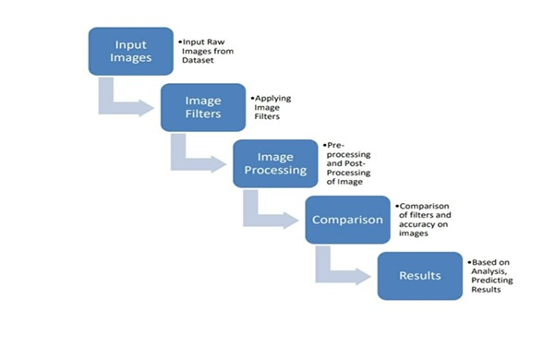
SYSTEM MODEL
Figure 1

Slide 7
REQUIREMENT SPECIFICATION
Software Requirements
➢ Software : Matlab
➢ OpenCv Package : OpenCv
➢ Editor : Matlab
➢ Language : C++

Slide 8
Hardware Requirements
RAM : 8GB or above
Hard Disk : 2GB free space
Display : Desktop
Processor : ISP,DSP
Input Device : Keyboard & Mouse
Output Device : Monitor

Slide 9
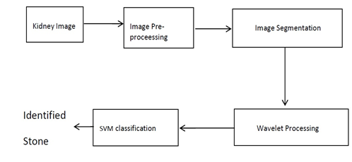
SYSTEM DESIGN AND ANALYSIS
Figure 2

Slide 10
Analysis
Kidney Image: The process begins with an image of a kidney.
Image Pre-processing: The image undergoes pre-processing to enhance its quality and prepare it for further analysis.
Image Segmentation: The pre-processed image is then segmented to isolate the regions of interest, potentially containing stones.
Wavelet Processing: Wavelet processing is applied to extract relevant features from the segmented image.
SVM Classification: Support Vector Machine (SVM) classification is used to classify the extracted features and identify the presence of stones.
Identified Stone: The final output of the process is the identification of stones, if present, in the image.

Slide 11
SYSTEM IMPLEMENTATION
Programming Language Selection
C++ Language
C++ is a high-level, general-purpose programming language.
This language provides a straightforward, consistent and powerful interface for programming systems.
It is widely used for developing system software, application software and embedded systems.
C++ is used to fast execution and efficient memory usage.
It offers flexibility to design software at various levels(from hardware interaction to user application).

Slide 12
MATLAB SOFTWARE
Load the CT scan or ultrasound image of the kidney into MATLAB.
Image Preprocessing:
- Convert the image to grayscale.
- Apply filtering to remove noise.
- Normalize the image: normalized image.
Segmentation:
- Use thresholding to separate the kidney from the background.
- Apply morphological operations to remove small objects and fill holes.

Slide 13
Feature Extraction:
- Calculate the area and perimeter of the kidney.
- Extract texture features using Gray-Level Co-occurrence Matrices (GLCM).
Stone Detection:
- Apply a threshold to the GLCM features to detect stones.
- Label the detected stones.
Display Results:
- Display the original image with the detected stones marked.

Slide 14
OpenCV
OpenCV (Open Source Computer Vision Library) is one of the most widely used libraries in computer programming.
OpenCV-Python is not only running, because the background has a code written in C++, but it is also easy to extract and distribute (due to Python folding in the front).
This makes it a good decision to make computer vision programs more robust response to a specific type of event.

Slide 15
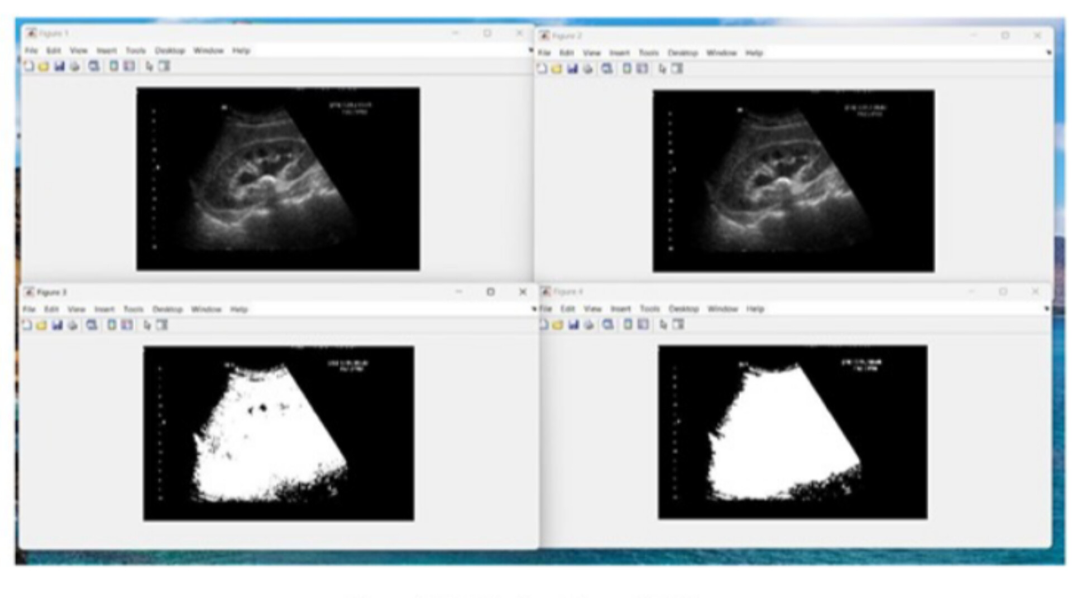
RESULTS
KIDNEY WITH STONE
Fig 3:Starting Stage of Kidney

Slide 16
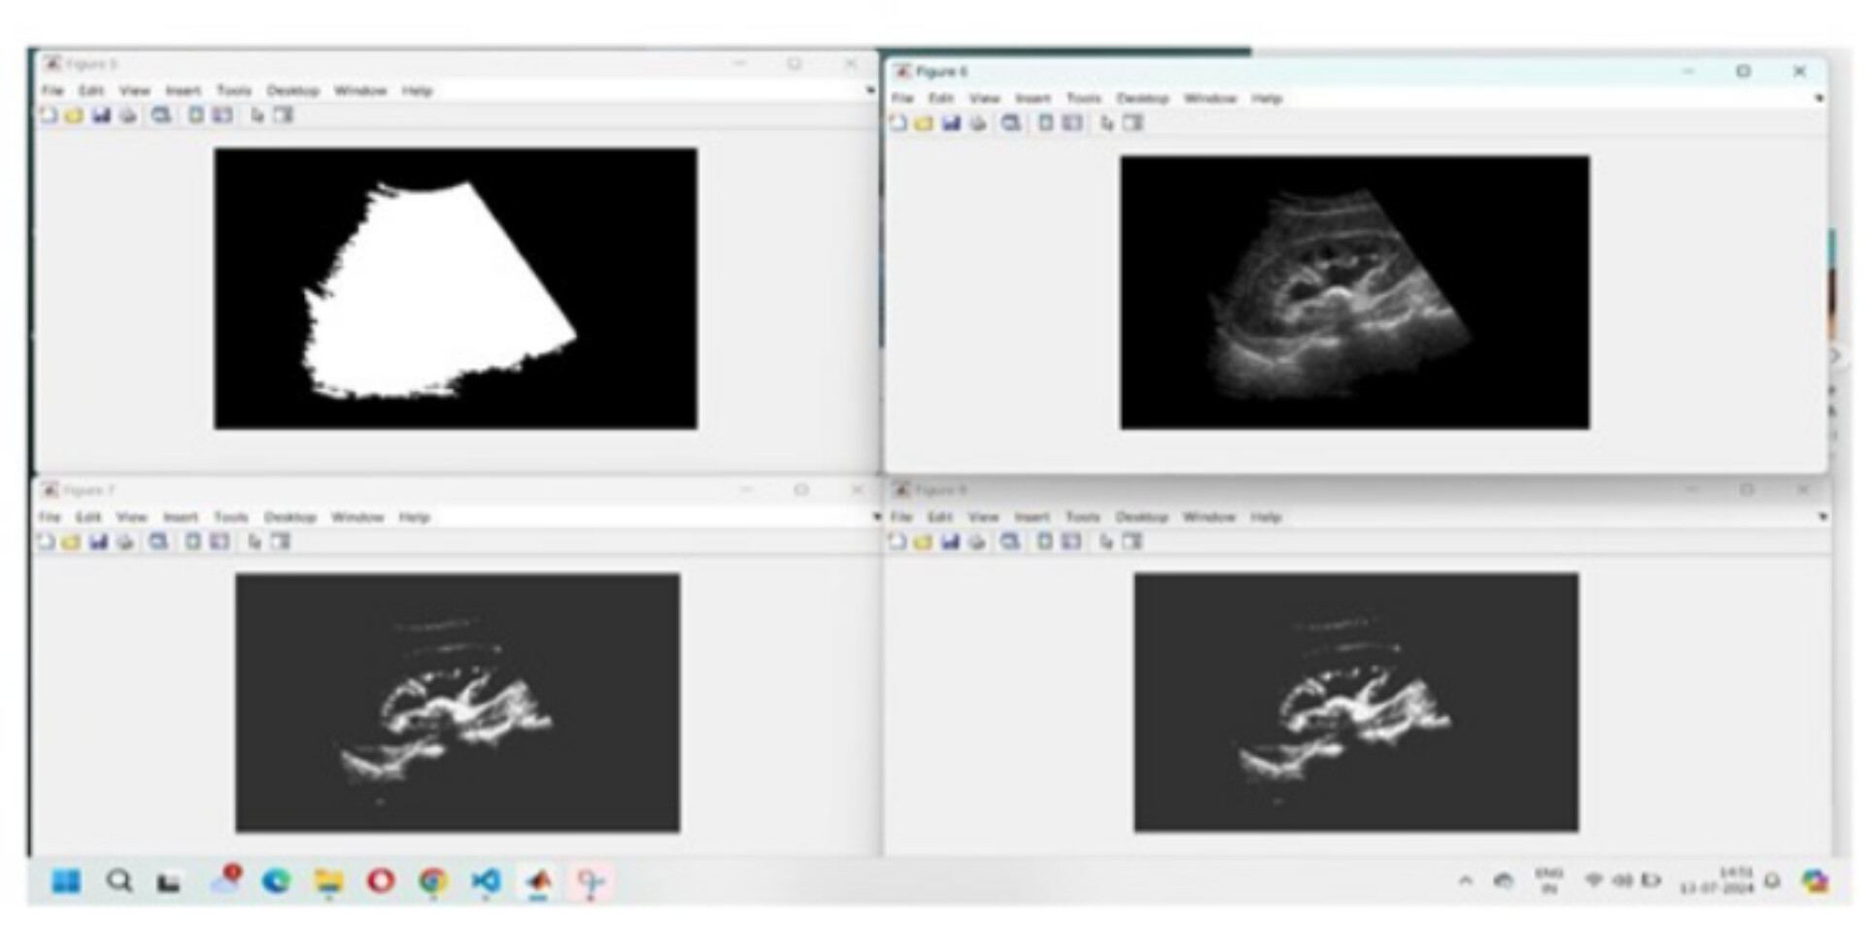
SEGMENTATION OF KIDNEY STONE
Fig 4:Scanning of Kidney Stone

Slide 17
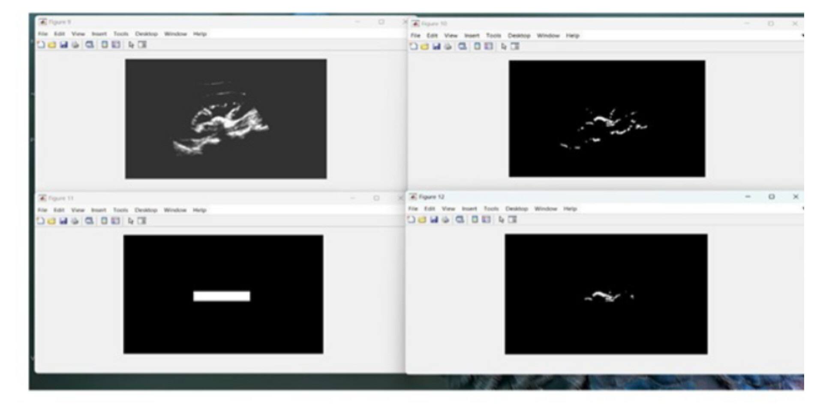
KIDNEY STONE DETECTION BY IMAGE PROCESSING
Fig 5:Detection of Kidney Stone

Slide 18
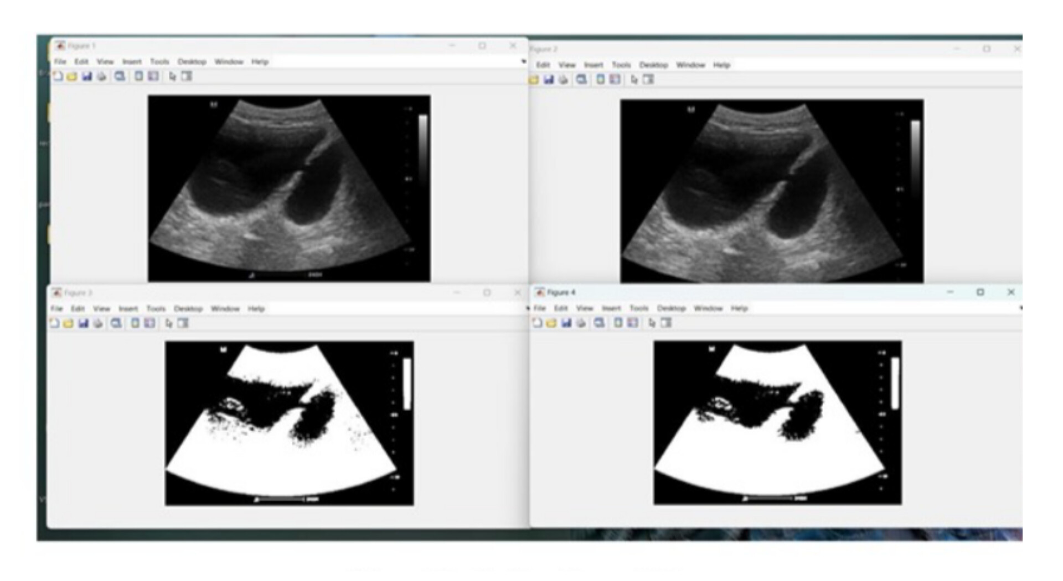
KIDNEY WITHOUT STONE
Fig 6:Starting Stage of Kidney

Slide 19
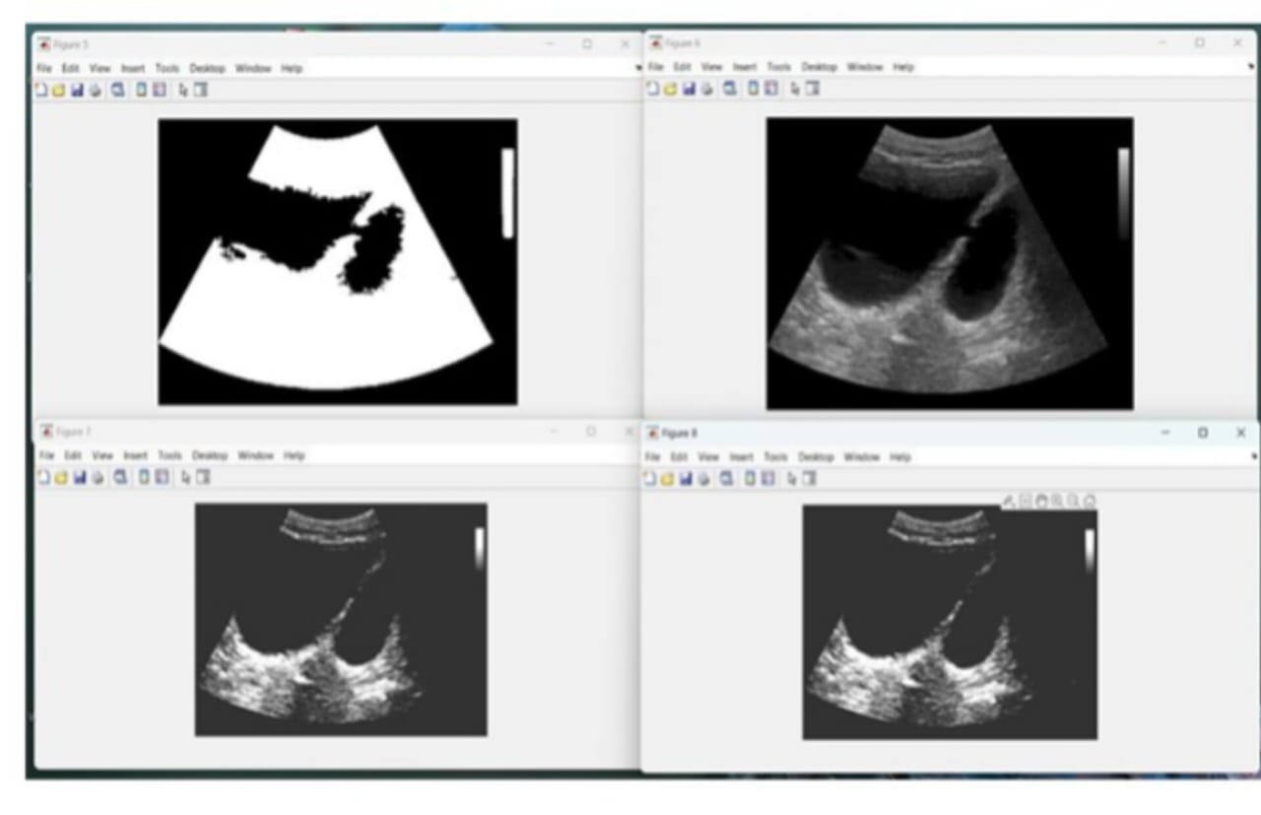
Fig 7:Recognition of Kidney Stone

Slide 20
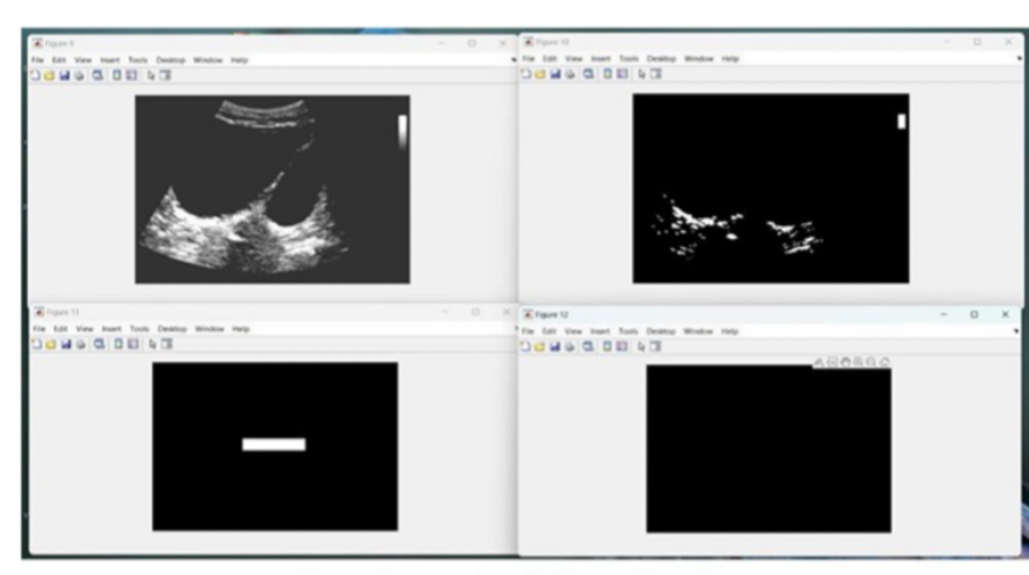
Fig 8:Detection of Kidney without Stone

Slide 21
CONCLUSION
This proposed preprocessing method for kidney stone segmentation will provide good support in detecting kidney stone.
Area-based thresholding can delete the bony skeleton from the image.
Location-based thresholding can reduce many false positive and bed mat region, because of using thresholding methods based on the prior knowledge of the image, the proposed scheme is simple and easy to under stand for segmentation.
The result we found is good and satisfactory, as limitation the proposed schemes will weak in robustness because it is completely reline the prior knowledge of the input image.

Slide 22
REFERENCES
[1] A. Sohgaura and P. Bigoniya, A Review on Epidemiology and Etiology of Renal Stone, Am. J. Drug Discov.
Dev., 2017.
[2] W. Wang et al., Prevalence of kidney stones in mainland China: A systematic review, Sci. Rep., 2017.
[3] I. Introduction, Distinguishing Staghorn and Struvite kidney stones using GLCM(Gray-Level Co-occurrence Matrices) and Pixel Intensity Matrix.
[4] W. Brisbane, M. R. Bailey, and M. D. Sorensen, An overview of kidney stone imaging techniques, Nat. Rev..,
2016.

Slide 23
[5] Y. Andrabi, M. Patino, C. J. Das, B. Eisner, D. V Sahani, and A. Kambadakone, Advances in CT imaging
for urolithiasis., Indian J. Urol., 2015.
[6] G. Chevreau et al., Estimation of urinary stone composition by automated processing of CT images, pp. 111.
[7] N. Kidney, U. Diseases, and I. Clearinghouse, Kidney Stones in Adults, NIH Publ., February 2013, 2012.
[8] W. Zhu, N. Zeng, and N. Wang, Sensitivity, specificity, accuracy, associated confidence
interval and ROC analysis with practical SAS implementations.

Slide 24
THANK YOU

